Slide 1

Ethical and Legal Insight on Snap
Bharati Pradayini Kandakumar
Lasya Pathuri
Mahalakshmi
Francesca Mathew

Slide 2

Notes:
Hey everyone!!
I have a great news!!!

Slide 3
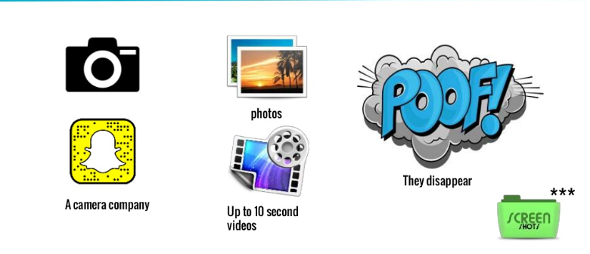
Introduction
What does Snap do?
Notes:
Snapchat is basically both a messaging platform and a social network.
It allows users to chat with friends by sending them photos, short videos up to 10 seconds long, after which PUFFFF, it disapperars.
Unlike other social networks, which keep your content online forever unless you decide to delete it, Snapchat's disappearing content makes online interaction feel more human and you need have to be so consiuos also about how many likes u got or the comments
Oh, I love my company!!!

Slide 4


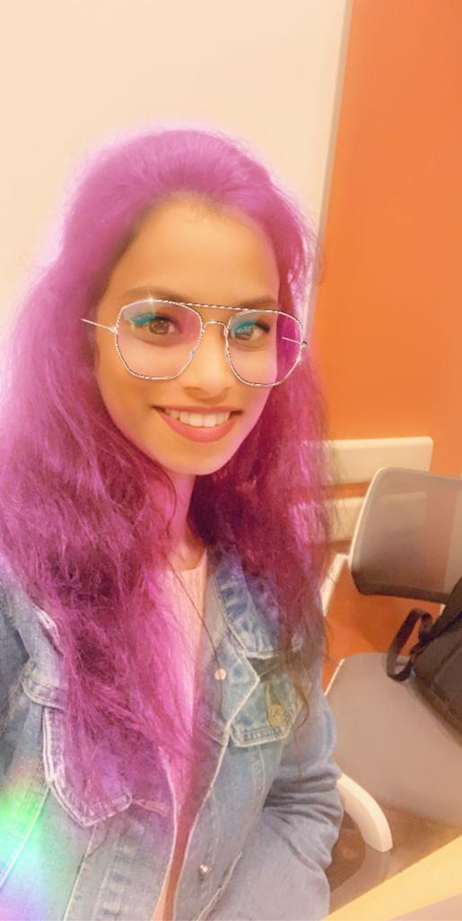

Introduction
Why is Snap different?
Notes:
Sanp also proivdes hundered of filters and its sooo fun u guys...

Slide 5
Code of Conduct
There's a reason the Sarbanes-Oxley Act requires that publicly-traded companies have a code of ethics
Principles for a Code of Conduct:
Respect for people
Ethical practices
Fairness
Legal requirements
Safety
Environmental regulations

Slide 6
‘Respect your Team’
By stating that they provide equal opportunity in all aspects of employment, Snap withholds the idea that all equals should be treated equally
It clearly demonstrates that they do not discriminate any individual based on the position or the ranking
And the statement that they will not tolerate illegal discrimination or harassment of any kind, makes it clear that every employee is protected equally in case of any disparities
‘ The Fairness or Justice Approach ’

Slide 7
‘Respect our Snapchatters’
Snap, through this statement, shows its commitment in protecting its one of their important stakeholders, i.e. their Users ‘Right to Privacy’
In this digital dominant world, any individual’s privacy protection is highly dependent on safeguarding their digital data
‘ The Rights Approach ’

Slide 8
‘Treat Others with Honesty and Fairness’
‘Avoid Conflicts of Interest’
Every individual may value certain virtues more than others. But, its individual’s duty to make sure that every actions and decisions must bring the overall good to the company as a whole
For example, if an important decision made by an individual, impairs the overall result of the company growth or its reputation, then every stakeholders related to the company will be affected and will have to face the circumstances
‘The Common Good Approach’

Slide 9
Other Elements
‘Unfair Competition Laws’ - An antitrust law
‘Trade Controls’
‘Anti-Boycott Laws’
‘Anti-Bribery Laws’

Slide 10

Code of Conduct
THE END

Slide 11


Code of Conduct
Respect for people
Ethical practices
Fairness
Legal requirements
Safety
Environmental regulations
Notes:
Hey wait, what about the conduct to safegaurd employees in the workplace. Health and safety or Drug and alcohol use . Doesn’t this seem kind of one-sided,
What about the duties that Snap as a company owes to its employees or the community it operates in, rite?
Hmm

Slide 12

Employment Diversity Tagline
Be Yourself, Every Day

Slide 13
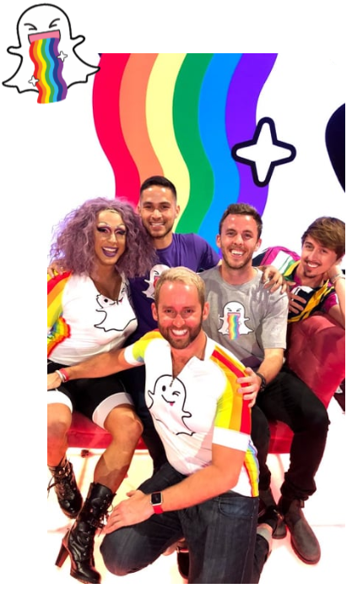
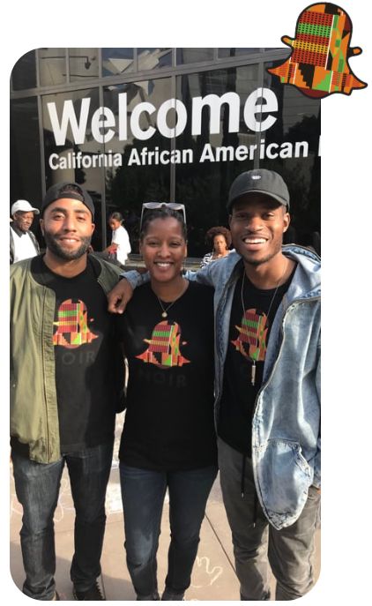
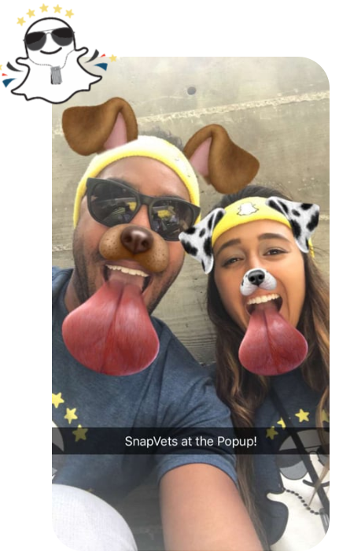
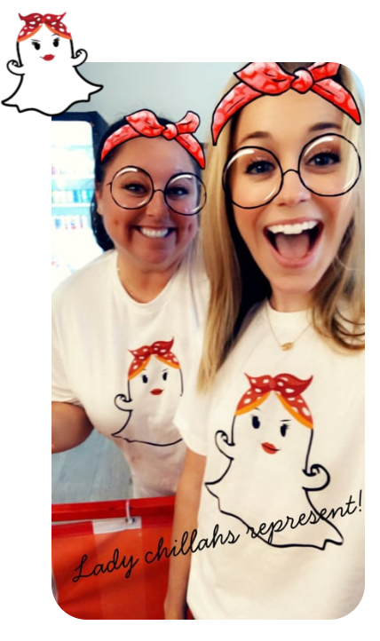
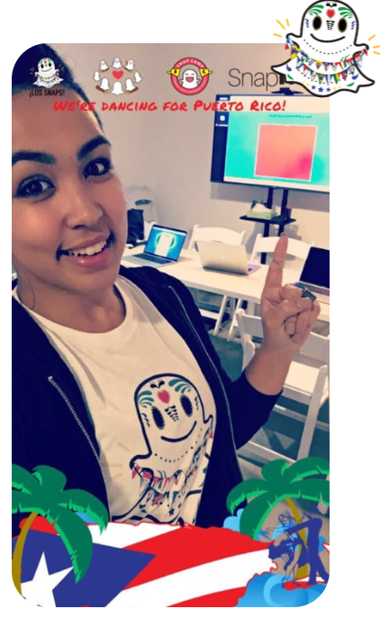
Fair Treatment for Protected classes
Employment Inclusion Programs
SnapPride | SnapNoir | SnapVets | Lady Chillahs | Los Snaps

Slide 14

Employment Challenges
“Insiders say working at Snapchat is like swimming in a shark tank”
Snap has been plagued by corporate governance issues such as
Inappropriate relationships
Short-lived Chief executives
FBI/DOJ/SEC investigations
Fired overworked staffs because of being “incomponent”
Lack of training
Hostile work environment
Former employees have reported that Snap management stifles dissent
Issues with Redesigning
Constructive discharge of employees with difference of opinion
Wrongful termination of a whistleblower employee who claimed inaccuracies in the reporting of DAUs
In a survey, 39.2% employees admit that they regret joining Snap

Slide 15

Gender Discrimination issues
During 2018, there were concerns that layoffs disproportionately targeted women
Additional cash and stock for those who raised concerns
Reached settlements with three women
Accusation from a former employee that the company has “Sexist” and “toxic” culture
Sexual jokes
In office pushup contests
Company parties with hired female dancers with revealing clothes
|| These accusation was not denied by management ||
|| Senior VP of engineering admitted that certainly they have more work to do in this aspect ||

Slide 16

Gender Discrimination Email Evidence
In an email, a former employee Lubetich lists "reminders" of all of the things an engineer can be
a person who takes more than two days off when their child is born
a person who isn't straight or doesn't want to get married and have kids
a person of color
woman
It implied that this list of trails are not valued at Snap and are viewed as a less "eligible” engineer
||The letter was a really good wake-up call for us,” said Snap CEO Evan Spiegel ||

Slide 17
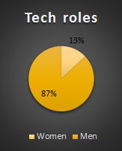
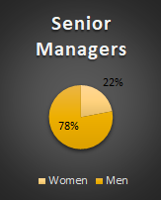
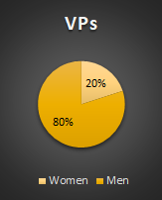
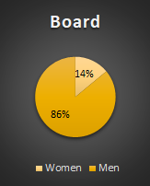
Snap’s response on Discrimination allegations
Snap now says that it’s working hard to remedy the issues highlighted by Shannon

Slide 18
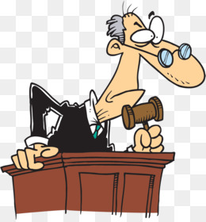
Employment Diversity and Discrimination - Judgement
World population - 52% women and 48% men
In IT related jobs - only 25% women and only 2% women from underrepresented minorities
Diversity in companies lead by example and contribute to human progress by breaking down systemic barriers that lead to people feeling excluded
Yet to publicly produce a diversity report
Snap has brought its 1st Diversity and Inclusion lead recently
Even though, Snap is making some efforts now, it has to do more to improve inclusion and should strive to be a leader when it comes to Diversity and Inclusion

Slide 19

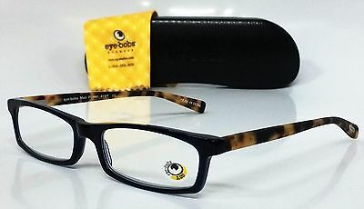
Eyebob v. Snap
IS SNAP’S USE OF THE SPECTACLES MARK ETHICAL WHEN THERE IS EXISTENCE OF AN UNDISPUTED TRADEMARK ON A SIMILAR LOGO?

Slide 20

Lawsuits Involving Snap
-|- EYEBOBS, LLC v. SNAP, INC
ISSUES IN CONSIDERATION
trademark‐infringement action brought by plaintiff Eyebobs, LLC against defendant Snap, Inc. against their attempted infringement upon the registered trademark of Eyebob as well as common law trademark
Eyebob is in the business of selling designs and reading glasses, including reading sunglasses
They possess an incontestable registered trademark on their brand symbol which consists of oval upward looking cartoon eyes often placed close to their brand name “Eyebobs” against a bright yellow background
This is further supported with an unregistered common law trademark that takes ownership of the cartoon designed eyeball itself
Snaps use of a similar logo on a commercial product “Spectacles” it is in the process of launching has raised concerns over its similarity to Eyebobs sunglasses and the continued goodwill it has accumulated over the years

Slide 21

Rules : What does the law mandate?
-|- EYEBOBS, LLC v. SNAP, INC
STATUTES & LAWS GOVERNING THE CASE
§ 35 of the Lanham Act for infringing the Registered Mark
provides a remedy in false advertising, trademark infringement and dilution cases allowing for a plaintiff’s recovery of illicit profits earned by a defendant that are attributable to its wrongful conduct
§ 43(a) of the Lanham Act for infringing the Common‐Law Mark
The owner of a famous mark that is distinctive , inherently or through acquired distinctiveness shall be entitled to an injunction against another person who at any other time after the owners mark became famous, commences use of a mark or trade name in commerce that is likely to cause dilution by blurring
Minn. Stat. § 325D.44 of the Minnesota law for engaging in deceptive trade practices
Prohibits among other things “passing off goods or services as those of another;” causing likelihood of confusion or of misunderstanding as to the source of goods/services;” and “engaging in any other conduct which similarly creates a likelihood of confusion or of misunderstanding.”

Slide 22

Analysis : Reasoning of claims against facts
-|- EYEBOBS, LLC v. SNAP, INC
CLAIM FOR INFRINGING THE REGISTERED MARK
Must establish : Prohibits and penalises a likelihood of confusion, deception, or mistake on the part of an appreciable number of ordinary purchasers as to an association between them due to their common use of the trademarks.
Framework
“SquirtCo factors” in determining the legality of claim
(1) the strength of the owner’s mark
(2) the similarity between the owner’s mark and the alleged infringer’s mark
(3) the degree to which the products compete with each other
(4) the alleged infringer’s intent to pass off its goods as those of the trademark owner
(5) incidents of actual confusion
(6) the type of product, its costs and conditions of purchase

Slide 23
Analysis : Reasoning of claims against facts
-|- EYEBOBS, LLC v. SNAP, INC
CLAIM FOR INFRINGING COMMON LAW MARK
Must establish : Eyebobs must establish that Snap’s use of the Spectacles Mark is likely to cause consumers to mistakenly believe that Eyebobs or its products are affiliated with Snap
Framework
The conceptual strength of the Common‐Law Mark is probably not as strong as the conceptual strength of the Registered Mark given that the Common‐Law Mark is suggestive,while the Registered Mark may be arbitrary or fanciful (highest level of trademark protection)
The common law trademark consists of only the eyeball logo, the Common‐Law Mark is more similar to the Spectacles Mark than is the Registered Mark—at least when the Spectacles Mark is used without the word “Spectacles.”
As the record reflects, Snap has not engaged in sustained or large‐scale advertising of Spectacles. Instead, Snap’s promotion of Spectacles appears to have been limited to setting up temporary Snapbots, and selling Spectacles on a dedicated website

Slide 24
Analysis : Reasoning of claims against facts
-|- EYEBOBS, LLC v. SNAP, INC
CLAIM FOR INFRINGING MINNESOTA DECEPTIVE TRADE PRACTICES LAWS
Must establish : Eyebobs must point to evidence demonstrating “that the harm is certain and great due to passing off goods/services as another’s and of such imminence that there is a clear and present need for equitable relief”
Court arguments
The harm that is anticipated by Eyebob is that of “reverse confusion” where the plaintiff (the smaller senior user) fears that its mark will be overwhelmed when the defendant (the larger junior user) saturates the market with its (infringing) mark
Eyebobs does not seriously argue that the Registered Mark has already been overwhelmed, but instead argues that, in the future, the Spectacles Mark is likely to gain sufficient commercial strength to overwhelm the Registered Mark
Eyebobs products are not sold in proximity to Spectacles; no shopper will ever see them sitting next to each other on a shelf or appearing next to each other on a web page. Thus, for actual confusion to arise, Snap would first have to so saturate the market with the Spectacles Mark

Slide 25



Conclusion :
-|- EYEBOBS, LLC v. SNAP, INC verdict delivered by Judge Patrick J Schiltz
confusion, not competition, is the touchstone of trademark infringement.

Slide 26

Conclusion :
-|- EYEBOBS, LLC v. SNAP, INC
Eyebobs has failed to demonstrate that it is likely to suffer irreparable harm if Snap is not enjoined from using the Spectacles Mark
Competitive- Proximity factor - there is almost no overlap between the reading glasses marketed by Eyebobs and the Spectacles marketed by Snap. They are very different products that are sold to very different consumers through very different channels. This worked against the plaintiff in this case
Not enough evidence in the record to suggest that, the Spectacles Mark has anywhere near the commercial strength that would be necessary to overwhelm the Registered Mark—particularly among consumers who buy Eyebobs’ products
Consumers who are purchasing expensive products, are likely to take care to ensure that they are getting exactly what they want. Spectacles retail for $129.99, and a consumer seeking to purchase Spectacles is going to ensure that she gets the one‐ and‐only hands‐free recording device that pairs with the Snapchat app. There is little chance that someone looking for a pair of Spectacles will mistakenly believe it to be Eyebobs causing reverse confusion

Slide 27
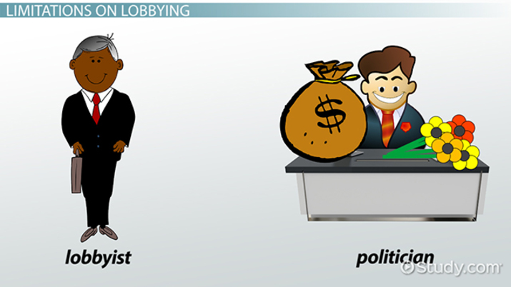
Government affairs strategy and methodology

Slide 28

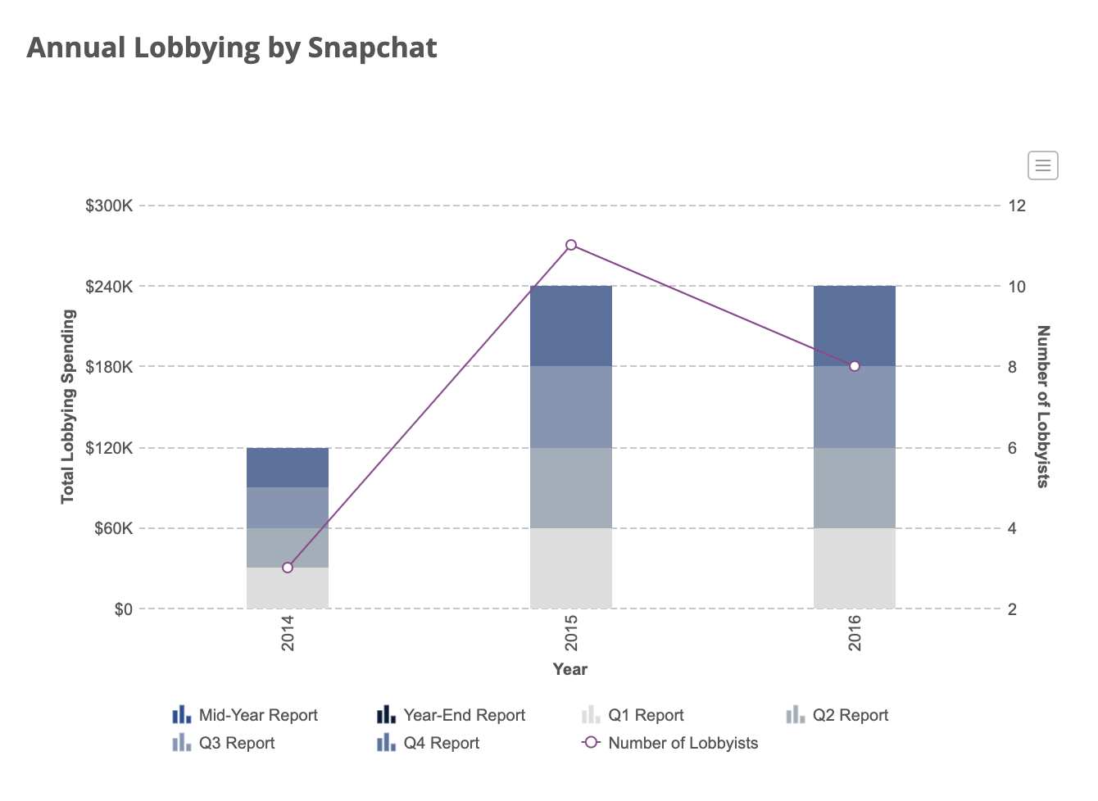
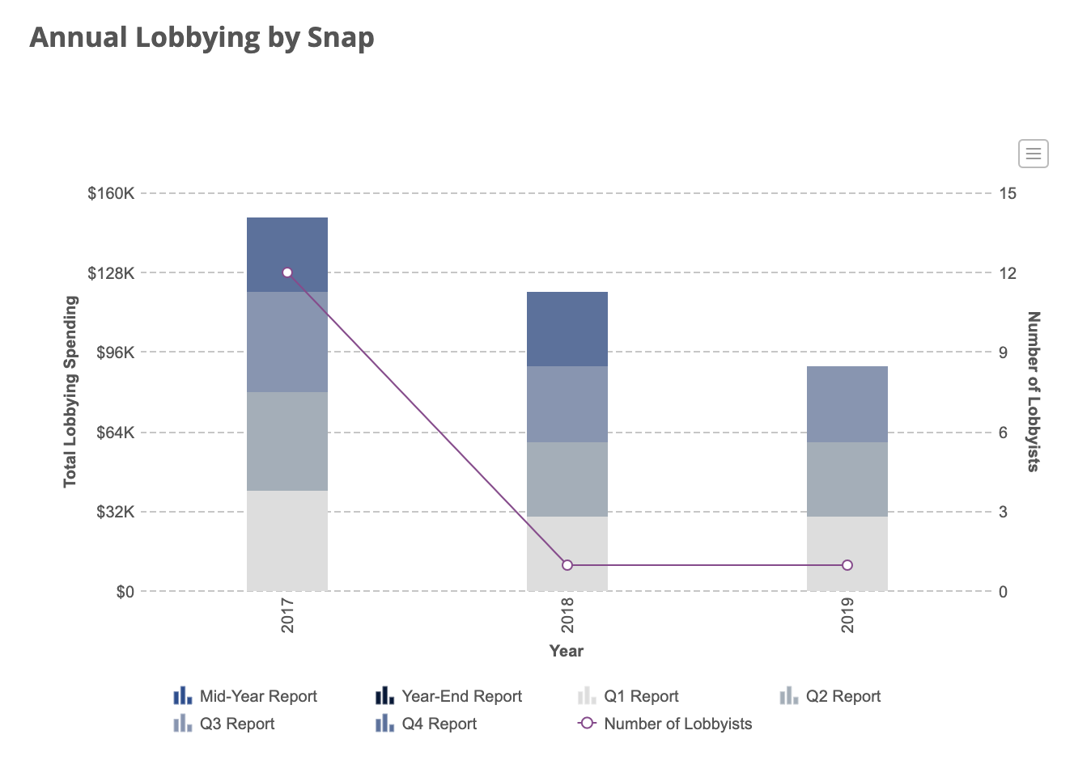
Amount Spent on Lobbying
Snap Inc. reported spending around $ 960,000 on lobbying. Most of the this amount is spent on Federal lobbying.
Notes:
Snap spent 960,000 dollars on lobbying till now. The company spent the maximum amount in the year 2016 of 240,000 dollars

Slide 29


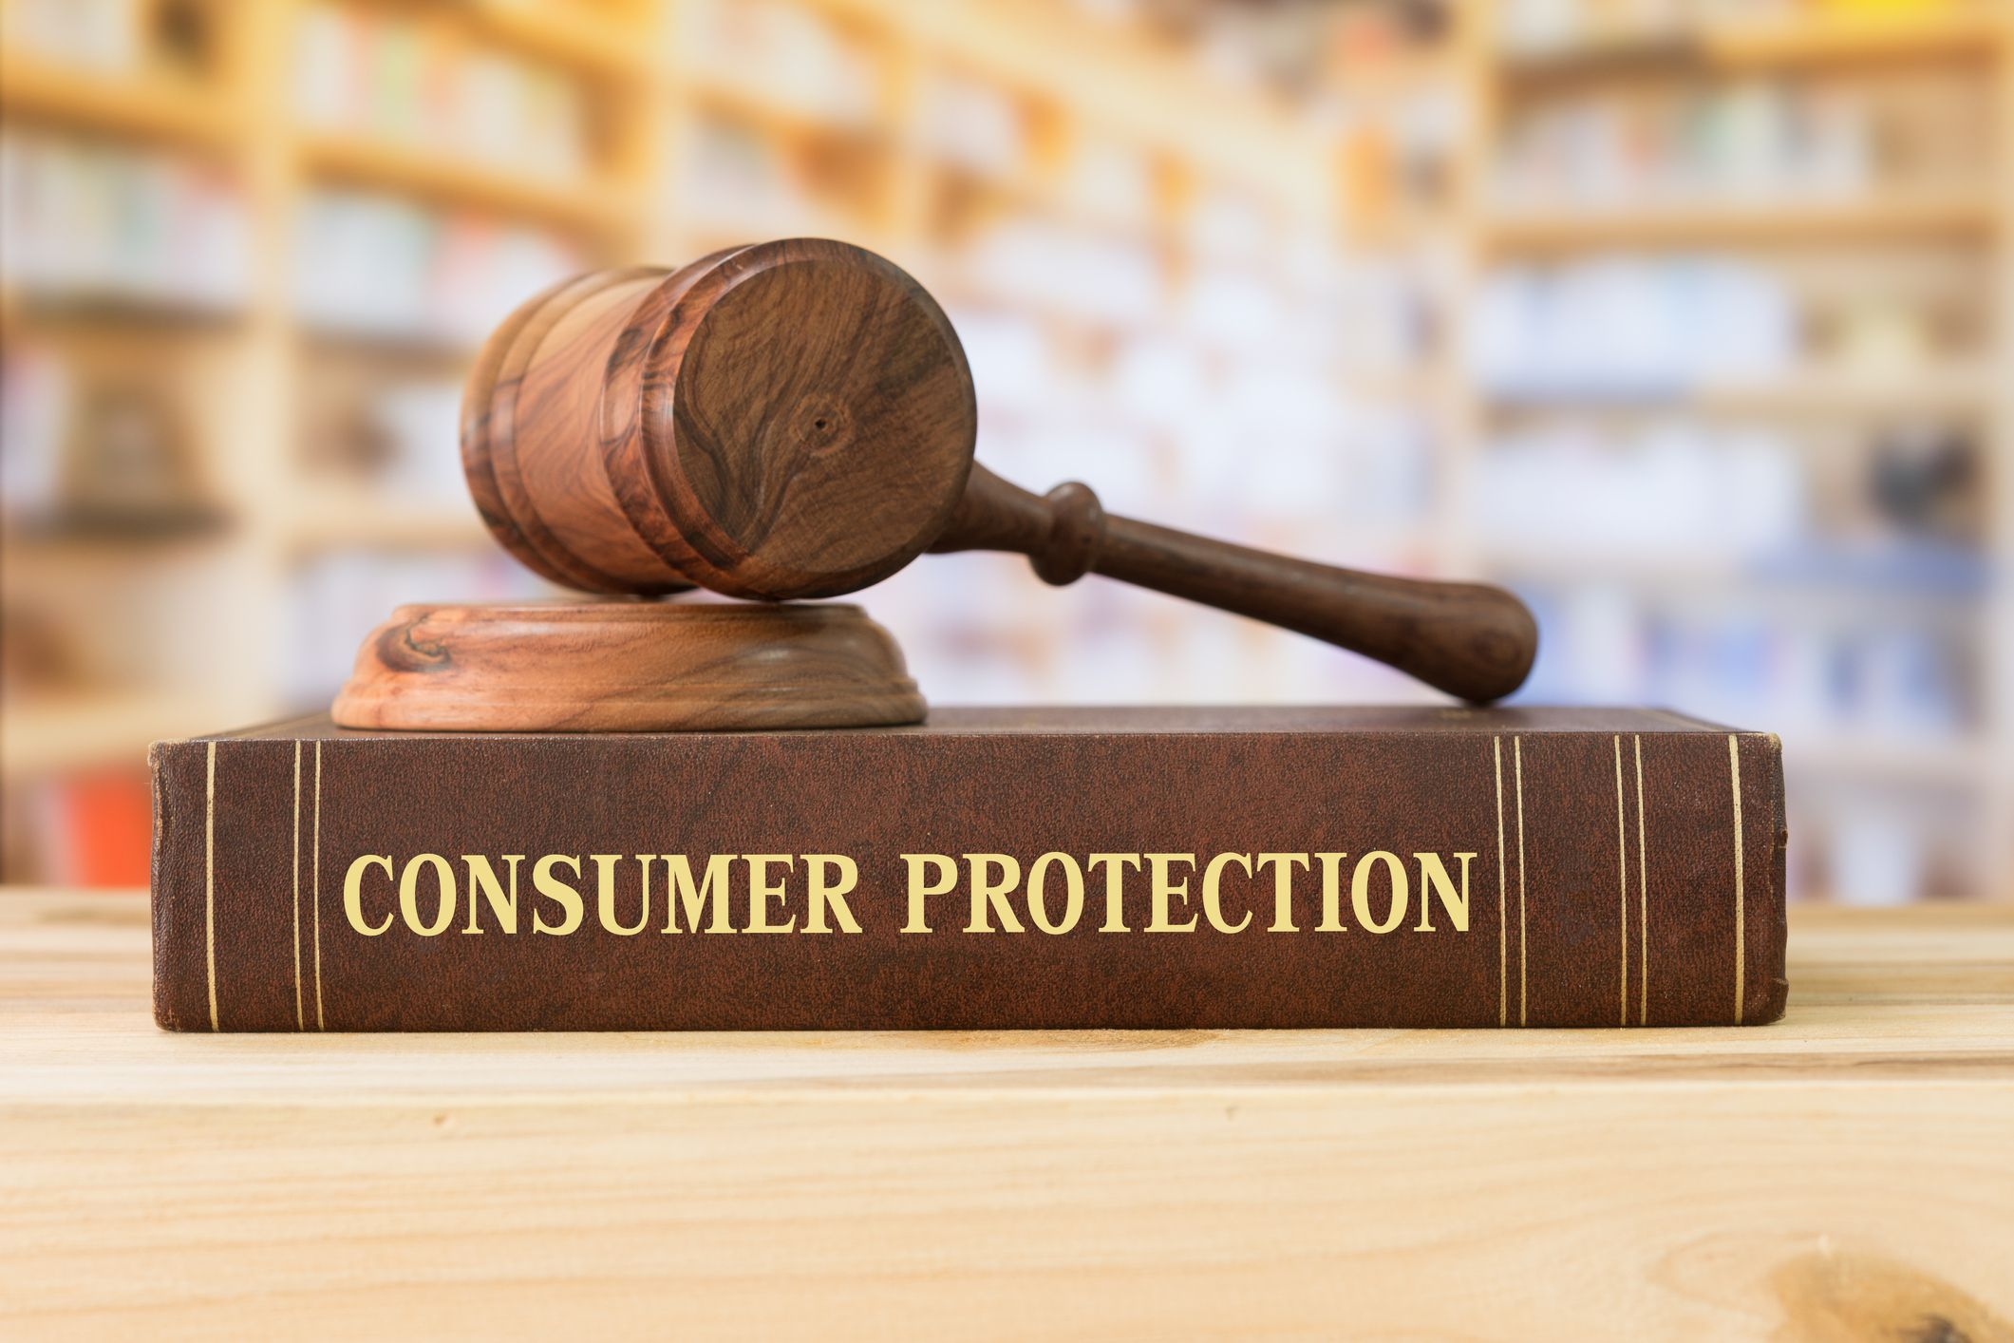
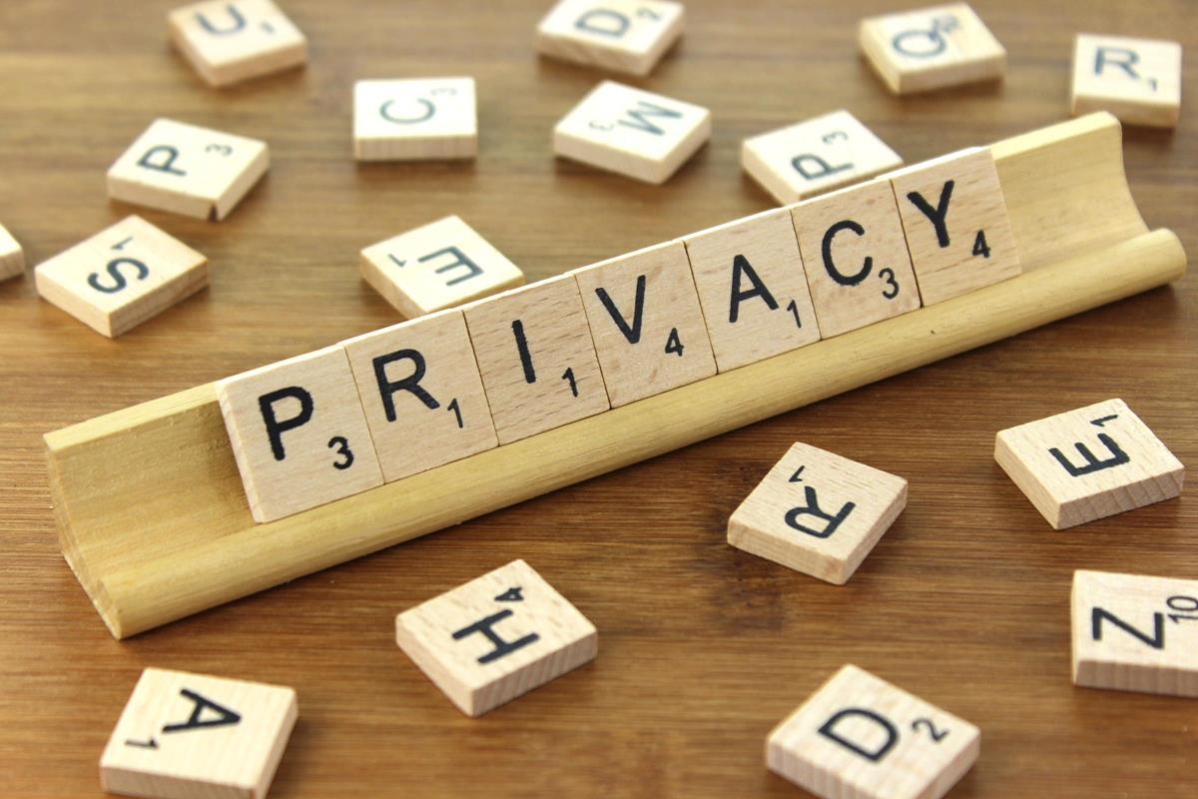



Issues Lobbied
Law enforcement cooperation
Consumer protection
Privacy
Safety
Data security
Intermediary liability
Notes:
Snap lobbied issues mainly related to

Slide 30


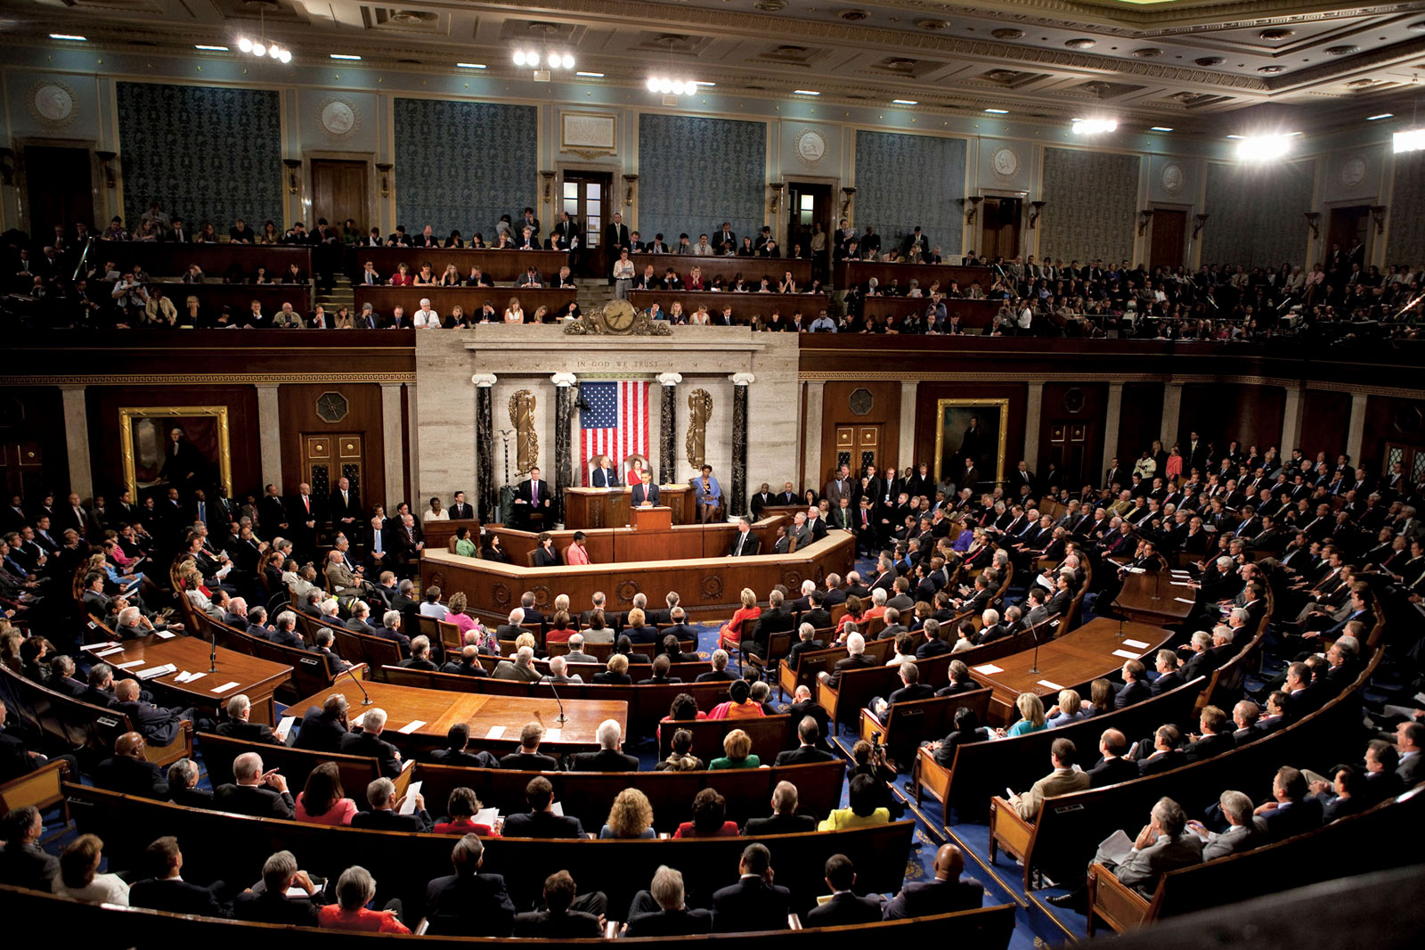


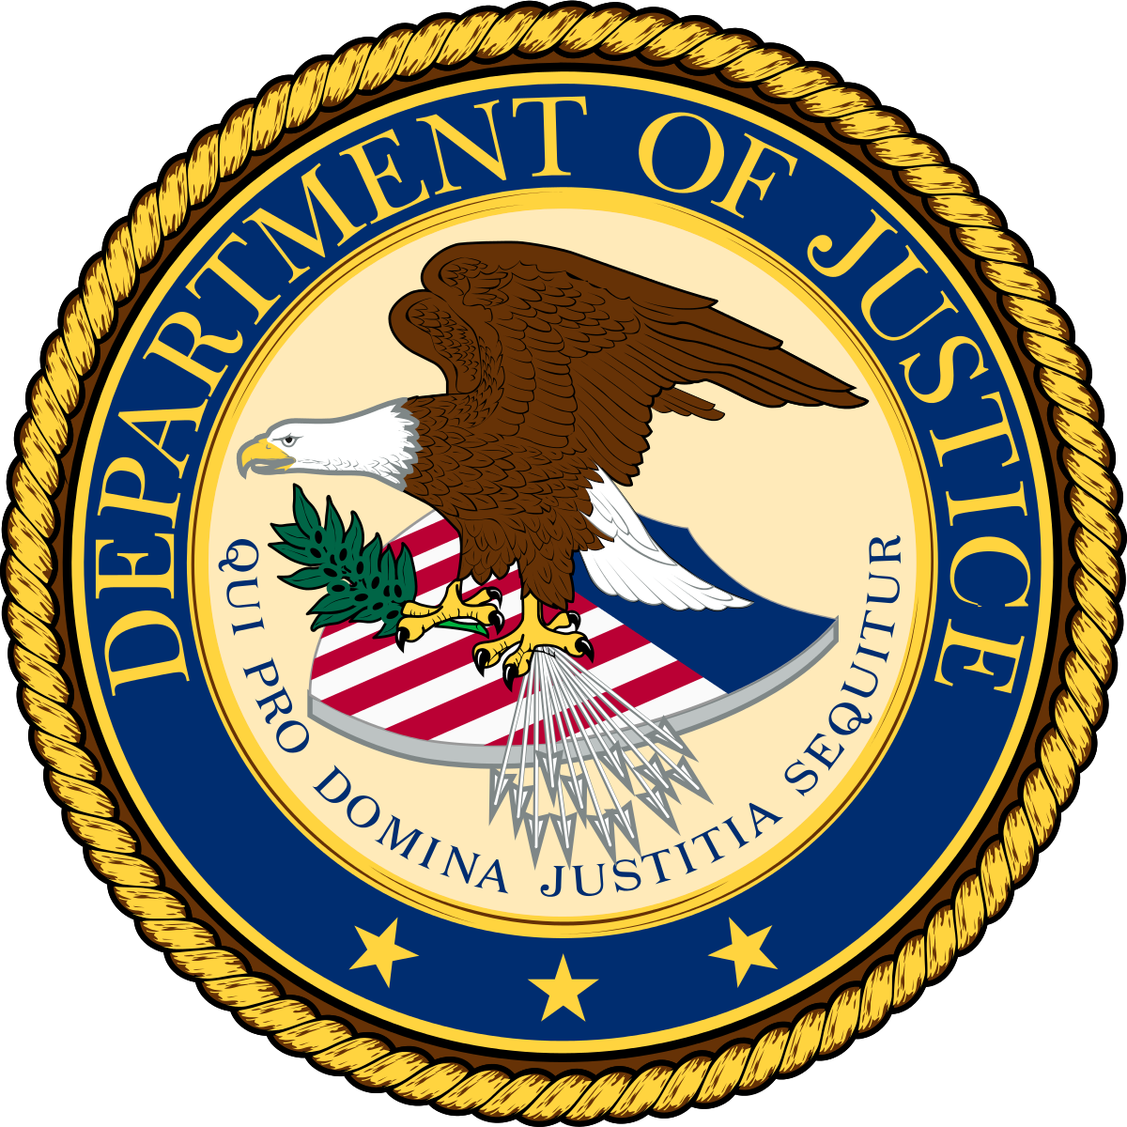
Agencies Lobbied
U.S. Senate
U.S. House of Representatives
Federal Trade Commission (FTC)
Natl Telecommunications & Information Administration (NTIA)
Dept of Justice (DOJ)
U.S. Senate and FTC are the major lobbied agencies by Snap.
Notes:
Agencies lobbied by snap include
US senate and FTC are the agencies which regulate public privacy and protection. So for a company like snap these are the major lobbying agencies.

Slide 31
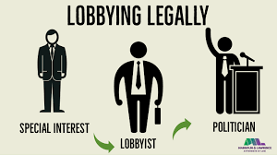
Government affairs strategy and methodology
In 2014, Snap first hired its first lobbyist Heather Podesta and Partners, LLC, a lobbying firm based in Washington D.C. This is just after the company’s major security breach.
Snap hired this firm as privacy experts called for an investigation from the Federal Trade Commission against this security breach. This firm helped Snap to promote policies favorable to the company and also educating policymakers regarding the application's operation and practice.
FTC also alleged Snap that the company deceived consumers over the amount of personal data it collected and the security measures taken to protect that data from misuse and unauthorized disclosure. In the settlement for this case Snap has to implement a comprehensive privacy program that will be monitored by an independent privacy professional.
In 2015, Snapchat has hired a second team of lobbyists, this time from a firm with Republican ties, to advocate for the app as Congress considers changes to information privacy legislation law. It has been hired to monitor policy related to data privacy, security and other issues impacting application based companies.
Notes:
Snap hired its first lobbyist in 2014, This is just after the company’s major security breach in which the user names and phone numbers of 4.6 million people were exposed via a vulnerability inside the app. The exploit was discovered in its Find Friends feature, which allows people to upload contact lists to Snapchat.
FTC filed a lawsuit against snap against this security breach. This firm helped Snap to promote policies favorable to the company and also educating policymakers regarding the application's operation and practice.
FTC also alleged Snap that the company deceived consumers about the images disappearing in 24 hrs and not stored. However the data is stored and Snap employee has access to the data which can be misused. In the settlement for this case Snap has to implement a privacy program that will be monitored by an independent privacy professional.
In 2015, when congress considers changes to information privacy legislation law, snap hired a second team of lobbyists, this time from a firm with Republican ties, to advocate for the app related to data privacy and security.

Slide 32
Government affairs strategy and methodology
In 2016 there is an allegation that the Snap Discover feature serves sexually explicit content to minors without warning.
In early 2017, Snap hired D.C.-based Monument Policy to help it in areas including “Technology, cyber security and lawful access,”
In 2017, Snap alleged issuing materially false and misleading statements to investors influencing its share price. Plaintiffs filed a class action. The U.S. Justice Department and Securities and Exchange Commission have subpoenaed Snap for information about its March 2017 initial public offering.
In 2018, Snap Inc. lobbied DOJ and also NATL for issues related to law enforcement cooperation.
In the year 2018 and 2019, Gina Woodworth served as a lobbyist for Snap for Issues related to consumer protection, privacy, safety, and data security.
Notes:
snap faced a lawsuit is hat the Snap Discover feature serves sexually explicit content to minors without warning. Snap hired another lobbying firm to help in areas of cybersecurity and lawful access.
We can see that the lobbying amount increased after every legal issue snap faced.
In 2017, a class action was filed against snap for misleading investors and influencing share price. This lawsuit is still going on and snap lobbied DOJ and NATL for this case.
In 2018 Gina woodworth joined as director pyblic policy of snap. She worked at internet associated as vice president of public and gov affairs.
Gina is serving as lobbying for snap recently for issues related to privacy and security.

Slide 33
Conclusion
Code of conduct - Needs improvement from the employees perspective
Employment Discrimination - Should definitely take more efforts to improve the company culture and have inclusion
Lawsuits - Can work on improving copyright infringement areas, thus avoiding further law suites
Lobbying - Privacy is the main concern

Slide 34

Thank You!!!

